Slide 1

OBJECT DETECTION AND ALERT SYSTEM
FOR VISUALLY IMPAIRED PEOPLE
Date: 08 April 2021
KURA PRAVALLIKA : 17WH1A0525
THOTA SAHITHI : 17WH1A0539
PALEPU PRIYOOSHA : 17WH1A0559
Internal Guide: Mr. M.SUGNANA RAO
Designation: Assistant Professor
Department of Computer Science & Engineering
BVRIT HYDERABAD College of Engineering for Women

Slide 2

Project Introduction
Why Should I Study this course?
DOMAIN
AI/ML
PROJECT TYPE
Existing System
An IoT device using proximity sensors helping to identify objects and alerting the user.
Objective
To develop an application which will help the visually impaired people to recognize objects in front of them.
Proposed system
Real time object detection and alert system using an application that will aid users in detecting and recognizing the objects in front of them. We will also design and implement an alarm system to notify the user about the recognized object using a voice assistant.
Examples
BVRIT HYDERABAD College of Engineering for Women

Slide 3
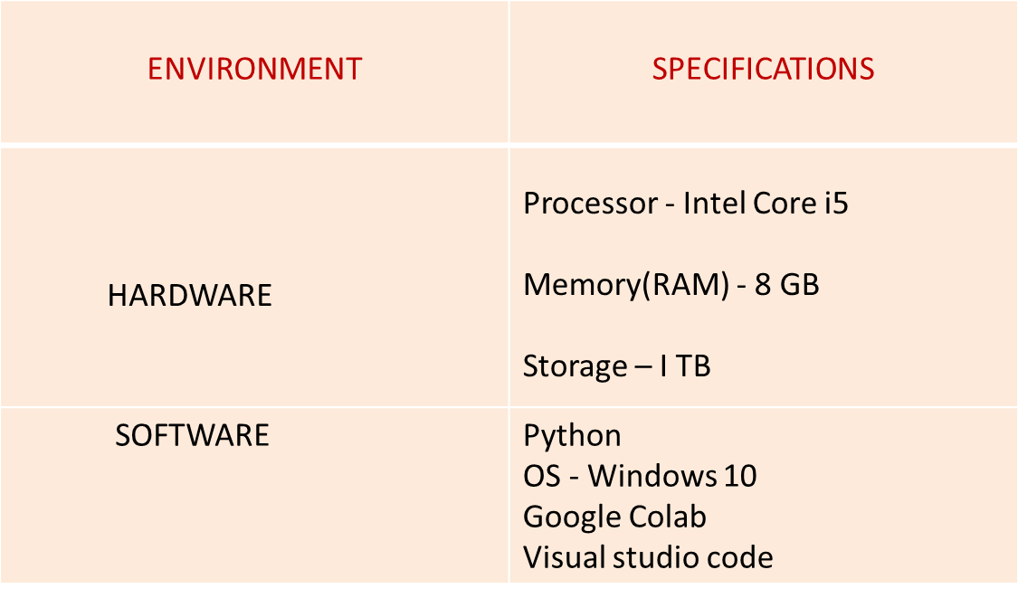
System specifications
Why Should I Study this course?
Examples
BVRIT HYDERABAD College of Engineering for Women

Slide 4
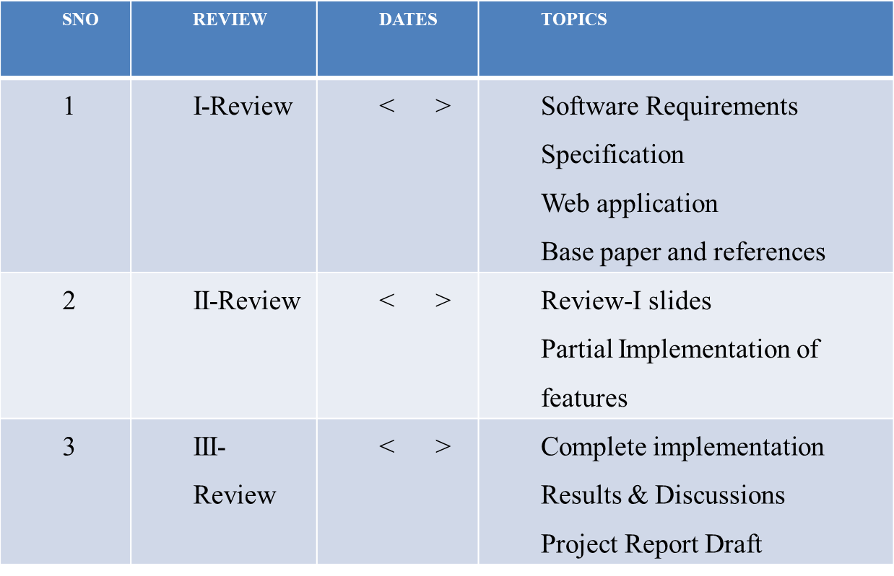
Project plan
Why Should I Study this course?
Examples
BVRIT HYDERABAD College of Engineering for Women

Slide 5
References
Why Should I Study this course?
Examples
[1] Base paper:
https://openaccess.thecvf.com/content_cvpr_2016/html/Redmon_You_Only_Look_CVPR_2016_paper.html
[2] References:
https://portal.unifiedpatents.com/patents/patent/US-8803699-B2
https://patents.google.com/patent/US9064172
BVRIT HYDERABAD College of Engineering for Women

Slide 6
Thank you
BVRIT HYDERABAD College of Engineering for Women

